Slide 1


Slide 2


Deduplication
& Name Formats
Nolan Regenwether

Slide 3

About Dignity Health
Dignity Health was founded in 1986
Fifth largest healthcare system in the US
Headquartered in San Francisco
Located in AZ, NV, CA
Around 60000 employees
28 foundations
Decentralized

Slide 4

Dignity Health Philanthropy Ranked #1
2016 AHP Top 10
Dignity Health
Children's Hospital Los Angeles
Seattle Children's Hospital
Sutter Health
Miami Children's Health System
Wake Forest Baptist Medical Center
Boston Medical Center
Hoag Hospital
UMass School of Medicine
MedStar Health
AHP = Association of Healthcare Philanthropy
1
30
System-wide foundation
Local foundations
$512 million
Raised in the last 5 years

Slide 5
Agenda
Name Formats Customization
Requirements
Name Format Research
Standardization
Types / Instances
Name Format Export Definitions
Deduplication Customization / Process
Requirements
Identification
Review Process
Merging Process
Post Merge Cleanup / Review Process

Slide 6


Name Formats Some Gender Stuff, too.

Slide 7
The Problem:
Incorrect name formats
Missing titles
Incorrect genders
Offensive results
No standardization

Slide 8
Initial Problem Continued
Criteria | Number of Occurrences | Example
and % | 58311 | and Mrs. Watters
Mrs. and Mr.% | 320660 | Mrs. and Mr. Mary Lou Judson
Mr. and Dr.% | 1775 | Mr. and Dr. Paul Qugana
Mrs. and Dr.% | 18533 | Mrs. and Dr. Morris
% % (Double Spaces) | 32215 | Andra Rieden
Notes:
Are ppl going to be able to recreate this graph?

Slide 9
Requirements:
Emily Post Style
Fail Gracefully
Professional Titles / Suffixes
Religious Titles / Suffixes
Military Titles / Suffixes
Same-Sex Couples
Married Couples
Hyphenated Names

Slide 10
The Research
Emily Post
Forums
Wedding websites
Same sex couple addressing web sites
Etc. Etc. Etc.

Slide 11
Formal Addressee
Use items in sets when they exist (First name, Middle name, Titles)
Include Familial / Religious Suffixes
Use Man’s Name for (Mr., Dr., etc.) and Mrs. as long as last name is same
Use full names for everything else
Ordering Dr. -> Mr. -> Mrs.
For Special Titles, both get last names separated by “and”
If no first names or titles, use last name + “Household” or “Family”
Mr. Sam S. and Mrs. Susan S. Smith
Dr. Susan Smith And Mr. Sam Smith
Sister Susan S. Smith, CSM
Mr. and Mrs. Sam S. Smith, IV
Mr. Sam Smith and Ms. Susan Scott
Mr. Sam Smith and Mrs. Susan Smith-Scott
Mr. Sam S. Smith
Dr. Susan Smith
Sister Susan S. Smith, CSM
Mr. Sam S. Smith, IV
Mr. Sam Smith
Mrs. Susan Smith-Scott

Slide 12
Formal Salutation
Use items in sets when they exist (First name, Middle name, Titles)
Include Familial / Religious Suffixes
Ordering Dr. -> Mr. -> Mrs.
Use titles (when both have them)
[Title] and [Title] [Last Name]
Falls back to first names
Falls back to Last Name + “Household”
Mr. and Mrs. Smith
Dr. and Mrs. Smith
Sister Susan S. Smith, CSM
Mr. and Mrs. Sam S. Smith, IV
Mr. Smith and Ms. Scott
Mr. Smith
Dr. Smith
Sister Smith, CSM
Mr. Smith, IV
Mr. Smith
Mrs. Smith-Scott

Slide 13
Informal Salutation
Use items in sets when they exist (First name, Middle name, Titles)
Include Religious Suffixes
First and First
Falls back to Titles
Falls back to Last Name + “Household”
Ladies first
Primaries first (if same sex) or alphabetical
Susan and Sam
Sister Susan
Susan

Slide 14
Informal Addressee
Use items in sets when they exist (First name, Middle name, Titles)
Include Religious Suffixes
First and First Lastname
Falls back to Titles
Falls back to Last Name + “Household”
Ladies first
Primaries first (if same sex) or alphabetical
Susan and Sam Smith
Sister Susan Smith, CSM
Susan Smith
Sam Smith

Slide 15
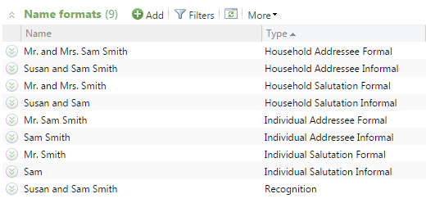
Implemented
The new standard 9 name formats we use are dynamic, correct, and fail gracefully while adopting an Emily post styling.
They are “correct”
They are dynamic

Slide 16
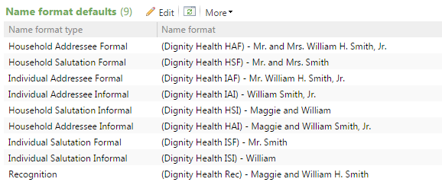
Defaults
Using ours as the default name formats.

Slide 17
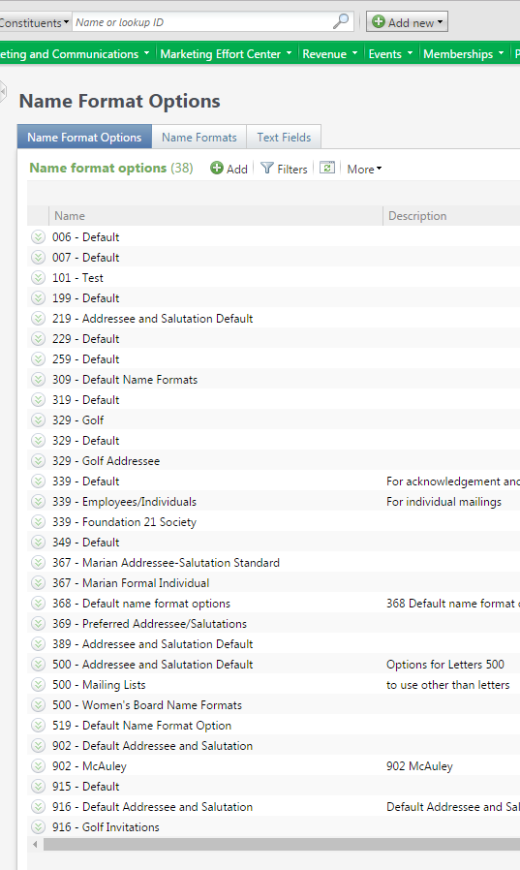
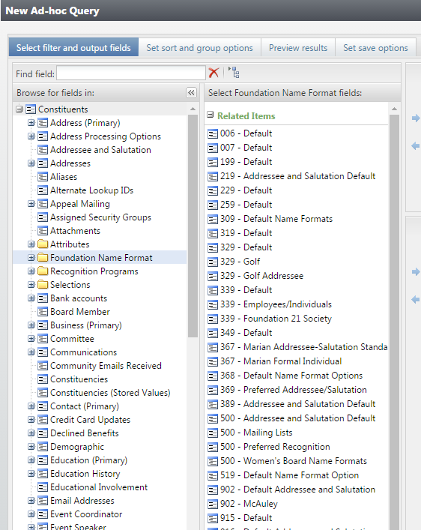
Name Format Export Definitions
We interpret the name format options and make them query-able.
Makes our letter generation around 1000 times faster.
Could be dynamic, too risky.

Slide 18
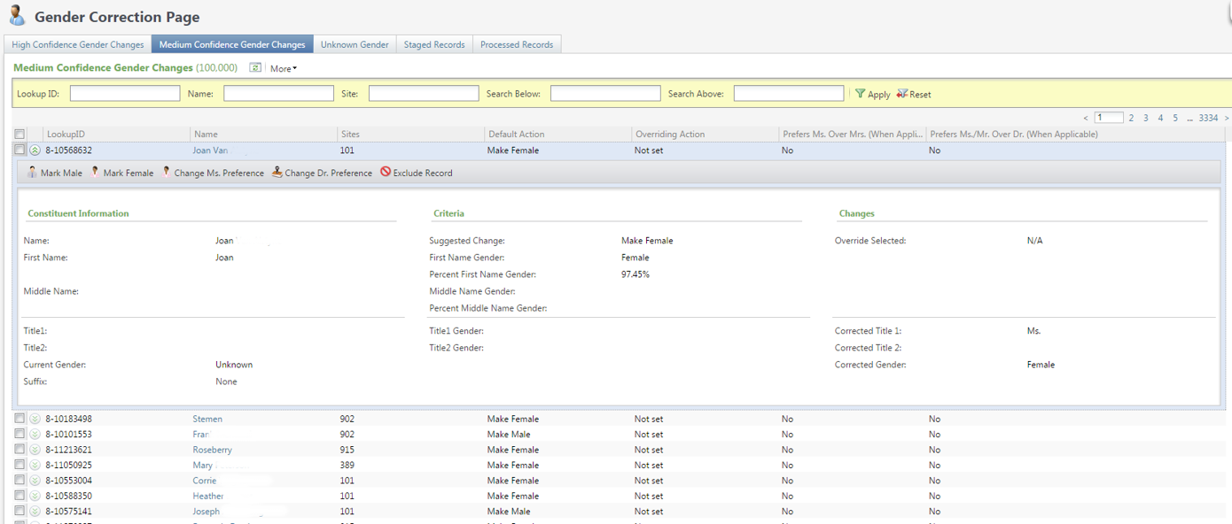
Gender Correction

Slide 19



Demo

Slide 20
DeDuplication

Slide 21
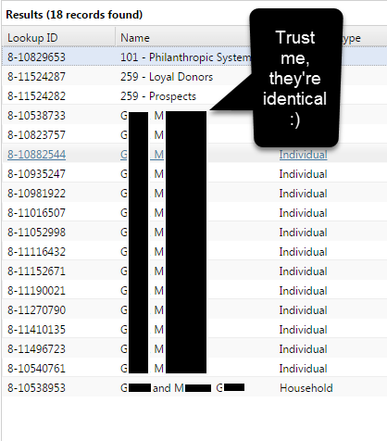
Initial Problem
32 Raiser’s Edge Databases combined into one CRM database.
Service areas are very close together.
Over 100,000 identified Duplicates

Slide 22
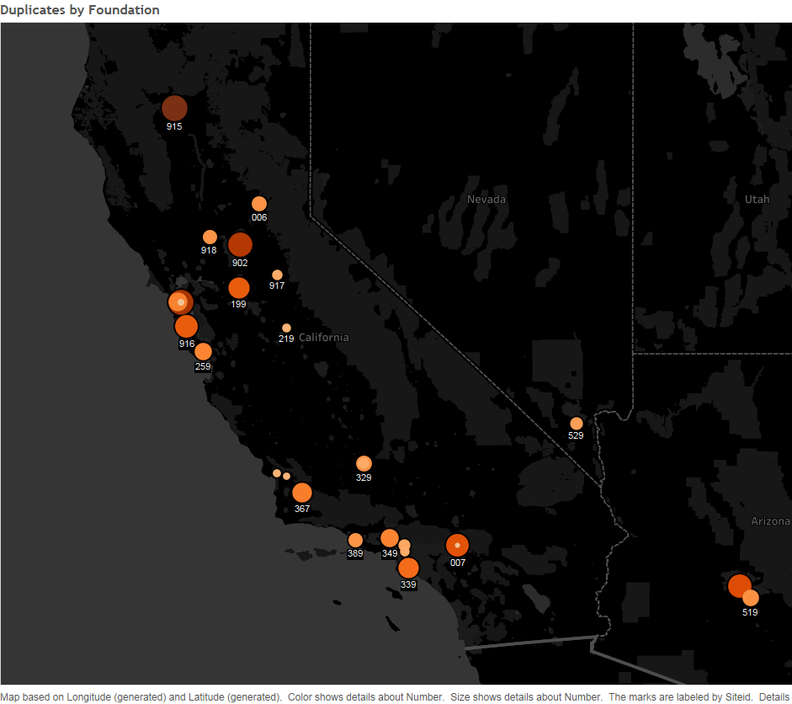
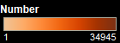
Initial Problem
Foundations are Very Close
Lots of Duplicates
Lots of Shared Duplicates

Slide 23
DeDuplication Process
1.
2.

Slide 24
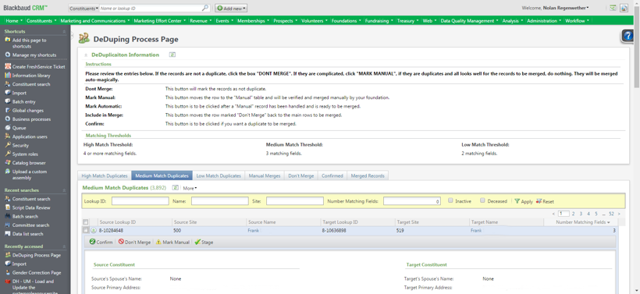
Review Process
Done within CRM
Users verify if constituents are duplicates.
Set thresholds and decide which constituents should be merged and which should not.
Provides Useful Information

Slide 25
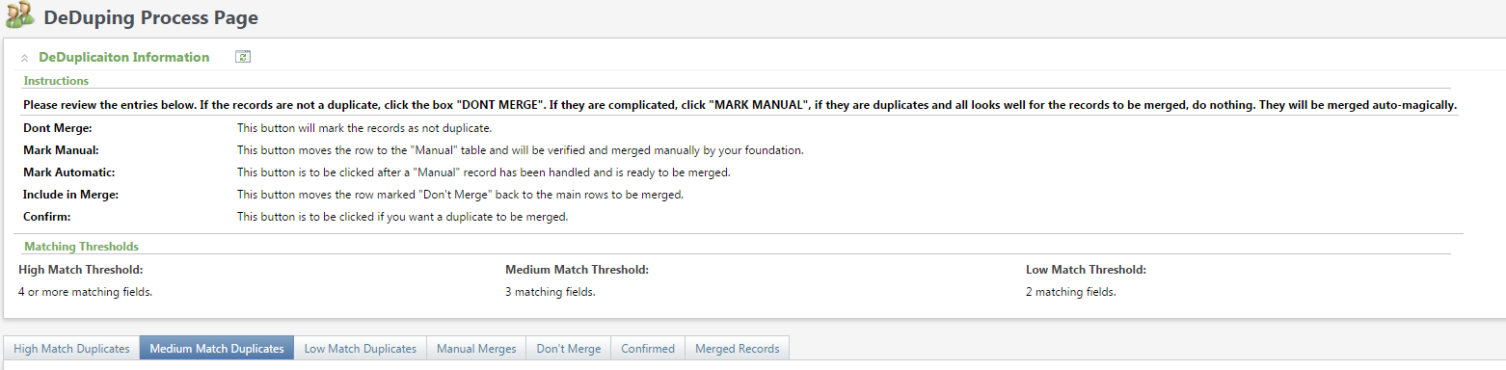
Review Page
Instructions
Merged Records OOB and Ours
Thresholds
Exclusion
Merges that need finished Manually
Confirmed Records

Slide 26
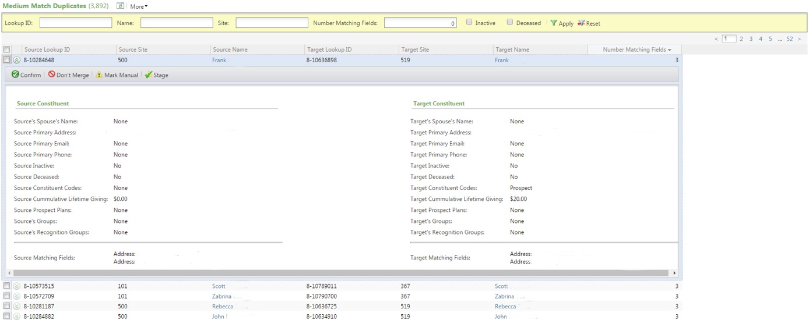
Review Page
Filtering
Linkage
Confirm, exclude, or stage from here
Constituent Information
Matching Information

Slide 27
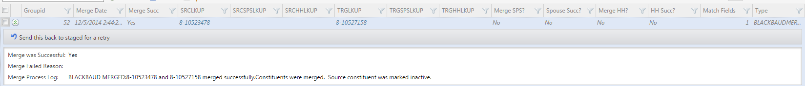
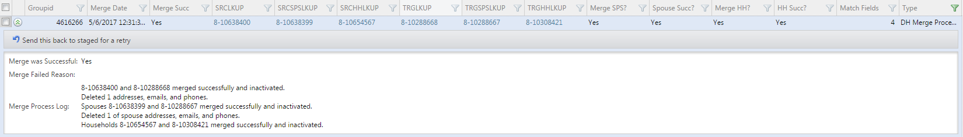
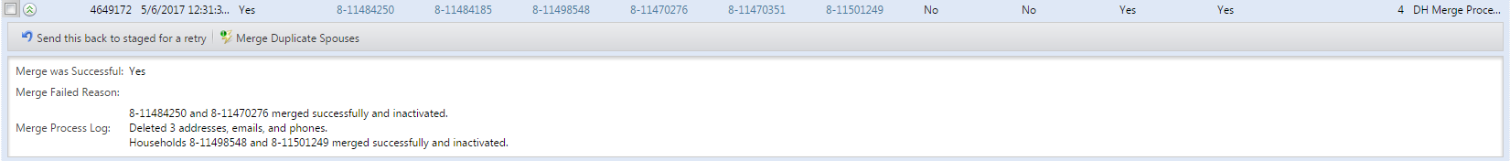
Merged Records Listbuilder

Slide 28
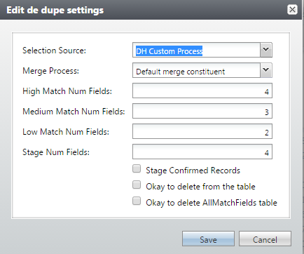
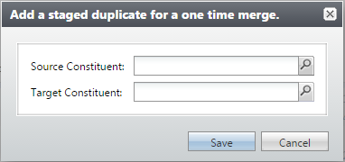
Admin and Settings
Here we have the one time merge process which adds a duplicate record directly to the staged table to be merged.
Here we have the settings for the whole deduplication process. Here we can clear tables, set thresholds, pick which selection source or merge process.

Slide 29
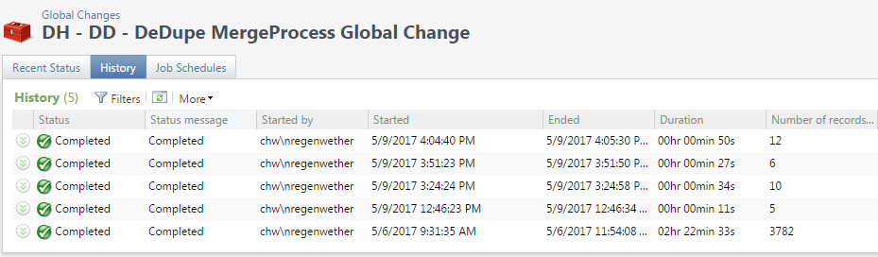
Merge Process Global Change
This is the global change which actually merges the records.
When a record is merged, its household and spouse are merged as well (as long as the spouse’s name matches).
Not merging these three things at once results in all kinds of messed up relationships and recognition credits.

Slide 30
Demo

Slide 31

Social Goodness
github.com/njregenwether
github.com/Non-ProfitCodeShare
BB Dev Network
njregenwether
Nolan.Regenwether@DignityHealth.org
Care to share? Reach out to trade code, customizations, recipes or baseball cards.

Slide 32


Thank you!

